Slide 1
Digital Engineering 1
Lecture 5

Slide 2
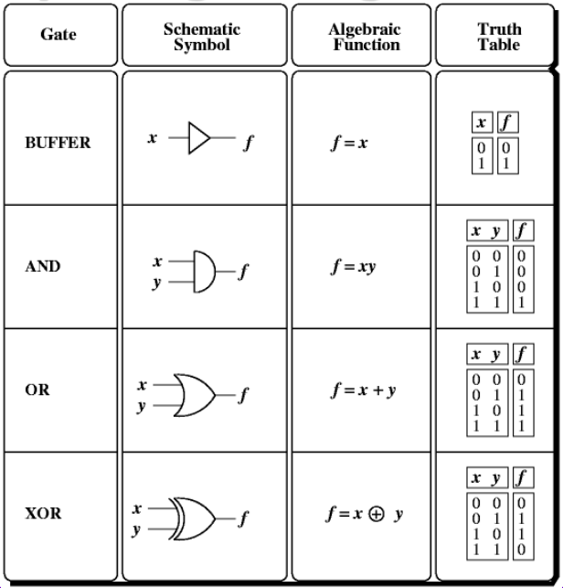
Digital Logic Gates

Slide 3
AND/OR CIRCUITS
Simplest type of combinational logic design consists of inverters, AND gates, and OR gates. This is known as an AND/OR circuit.
An AND/OR circuit can be designed to implement any function by performing the following steps:
Put the expression in SOP form
Form complemented literals with inverters
Form product terms with AND gates.
Sum the product terms with an OR gate

Slide 4

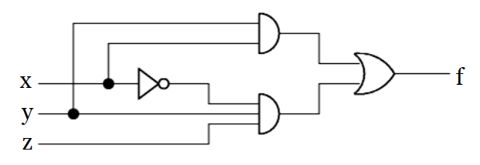
Example

Slide 5
Universality
All Boolean functions can be implemented using the set {AND, OR, NOT}.
Universal gates
Gates which can implement any Boolean function without the need to use any other type of gate
NAND and NOR are universal gates
To show universality of a gate: Show that AND, OR and NOT can be implemented using that gate

Slide 6
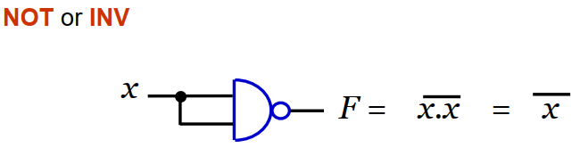
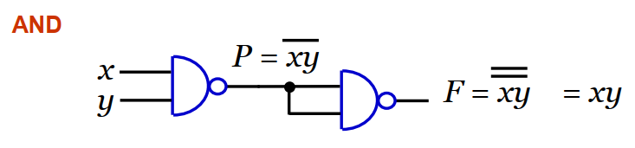
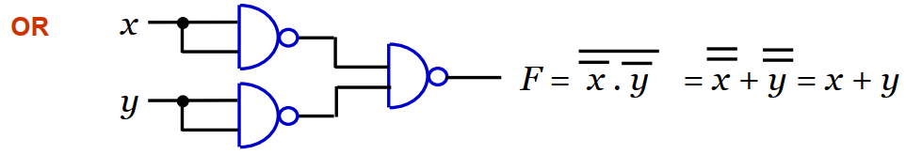
AND, OR and NOT can be implemented using NAND only

Slide 7
Assignment
Show that NOR gate is a universal gat
Show that XOR gate is a universal gat

Slide 8
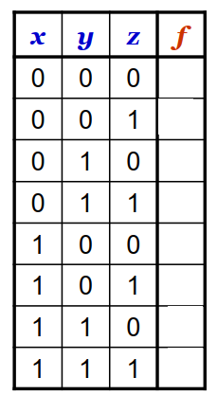
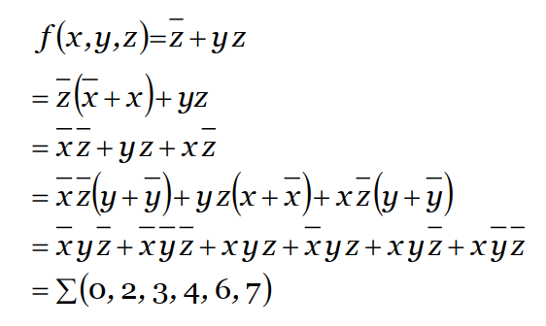
Boolean Expression → Truth Table
To convert Boolean expression to truth table: Expand the expression into the minterms (i.e., canonical SOP form) and enter 1’s in truth table rows (or, expand into canonical POS and enter 0’s for each maxterm)

Slide 9

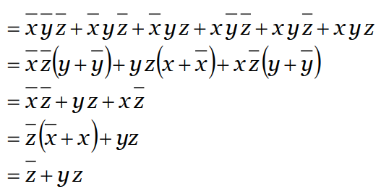
Truth Table → Boolean Expression
To convert a truth table to a boolean expression:
Write a canonical SOP expression that consists of all minterms (or write a canonical POS using maxterms) and then simplify the algebraic expression.

Slide 10
Truth Table → Boolean Expression
When the expressions get more complicated, simplification gets harder
You may miss out combinations
More inputs, more the effort
Systematic way to reduce effort
Karnaugh Maps

Slide 11
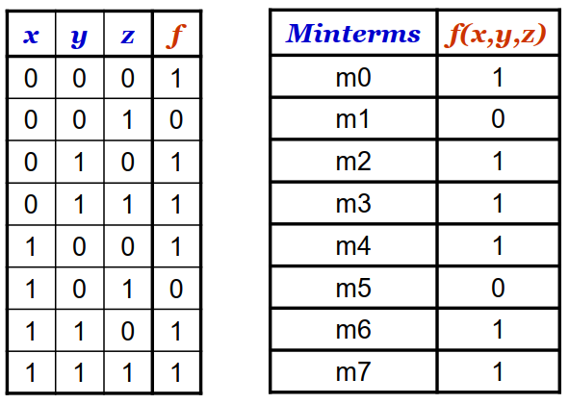
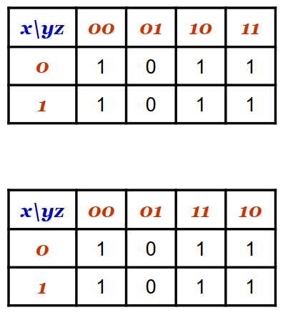
Rearranging Truth Tables

Slide 12
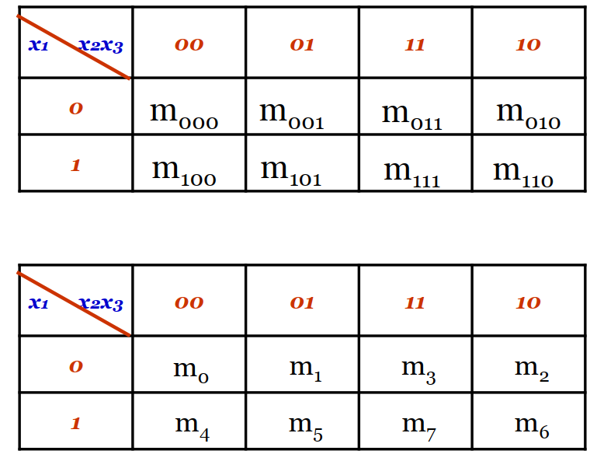
In General

Slide 13
Karnaugh Maps
Truth tables are a convenient form to represent equations but they don’t aid in the simplification of logic equations.
Karnaugh maps (K-maps) are similar to TT’s and they lead to graphical methods for Boolean expression simplification.
A K-map is a multi-dimensional tabulation of function values.
Each minterm is assigned an entry (a cell) in the table. The cell contains the value of the function for the corresponding minterm.

Slide 14
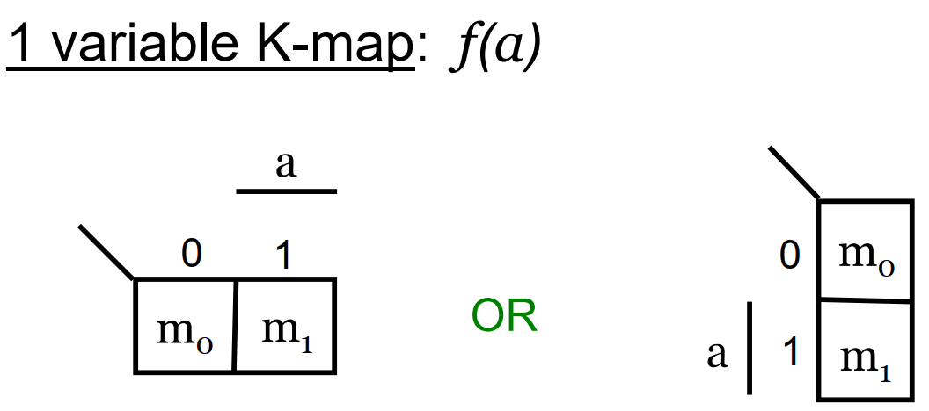
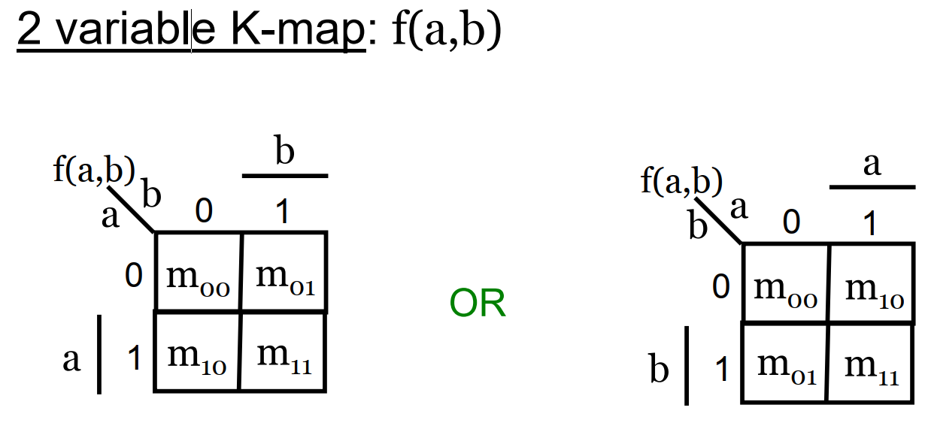

Slide 15
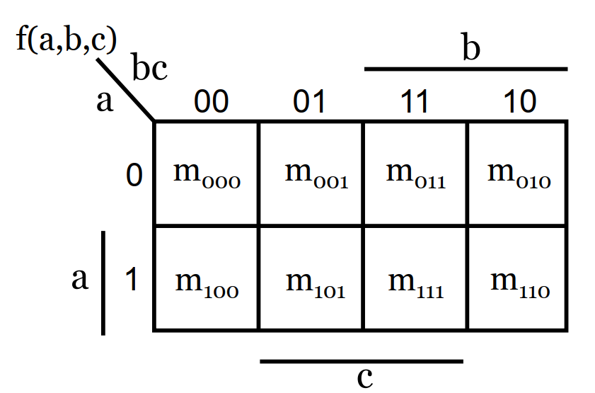
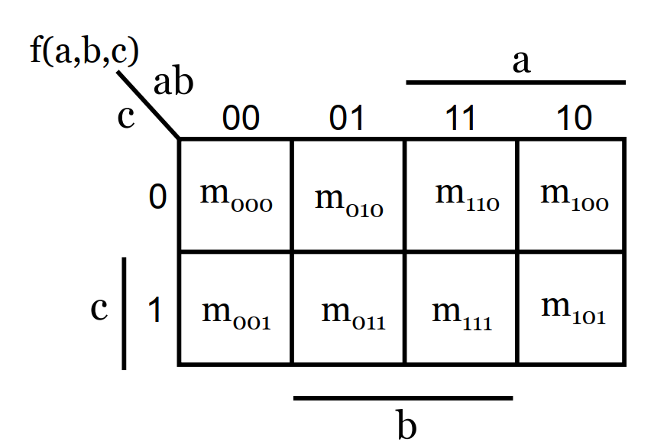
3-variable K-map: f(a,b,c)
OR

Slide 16
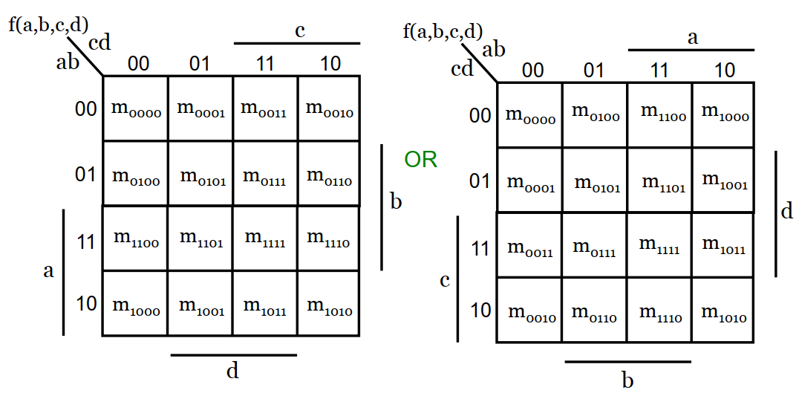
4-variable K-map: f(a,b,c,d)

Slide 17
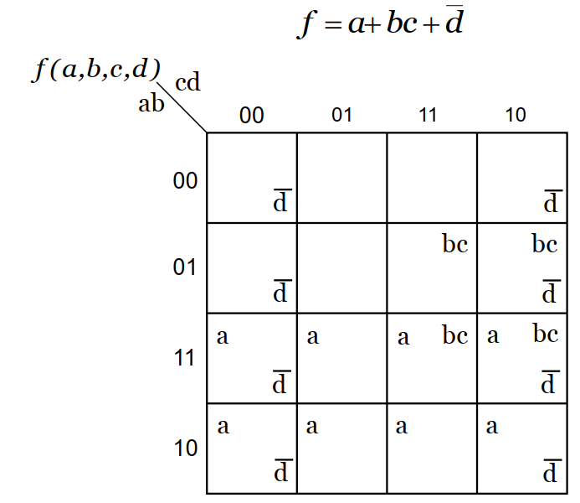
K-map Example 1

Slide 18
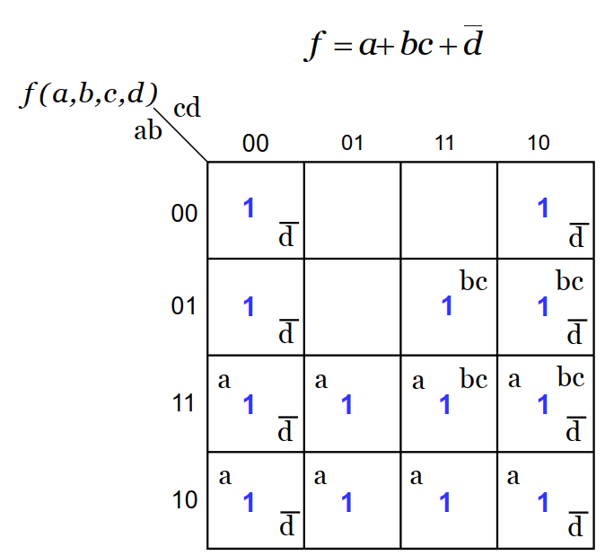

Slide 19
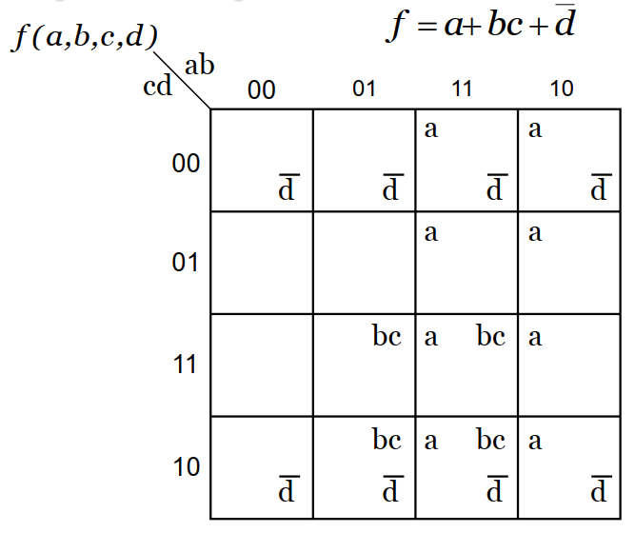

Slide 20
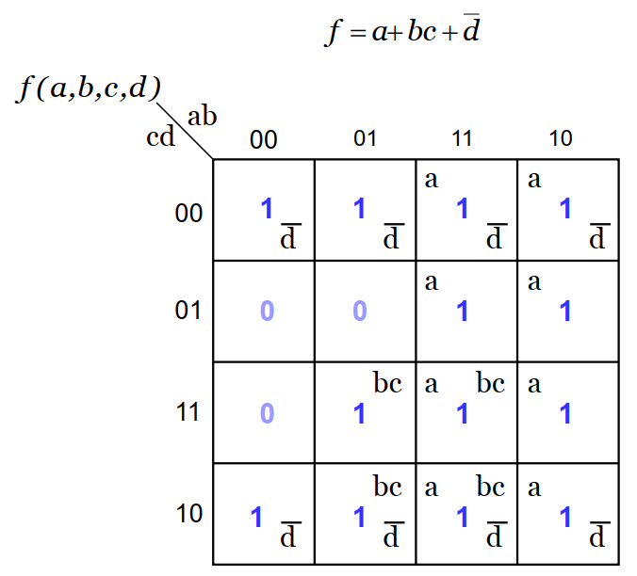

Slide 21
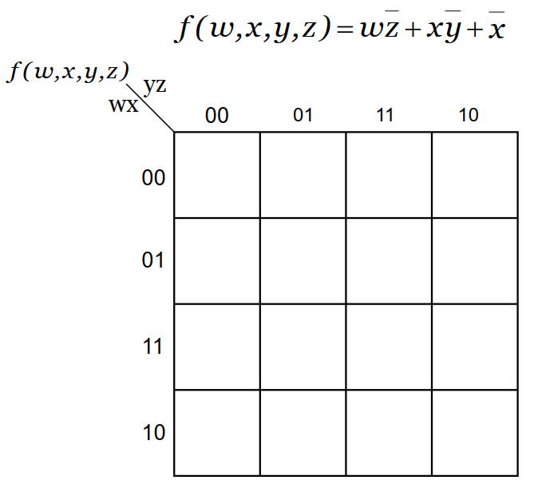
K-map Example 2

Slide 22
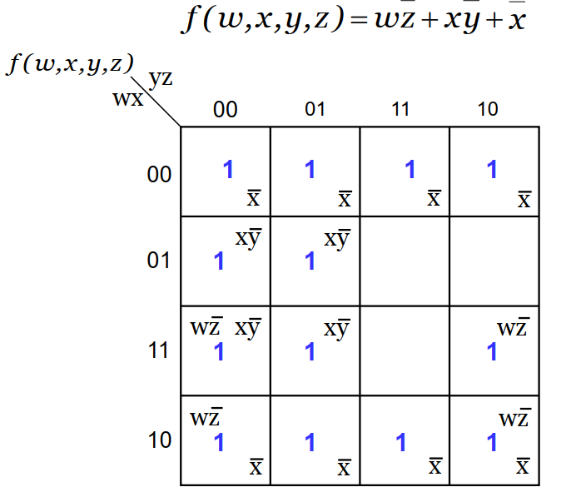

Slide 23
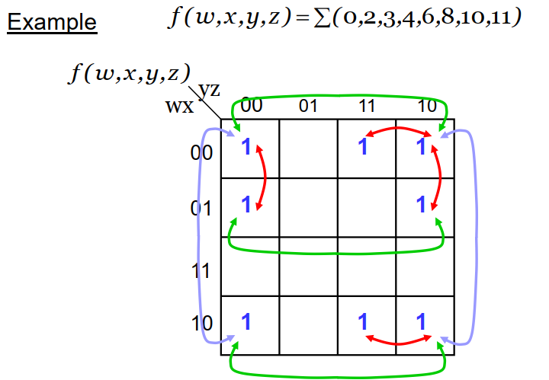
K-Map Properties
Minterms mapped to any two adjacent cells differ in exactly one bit position

Slide 24
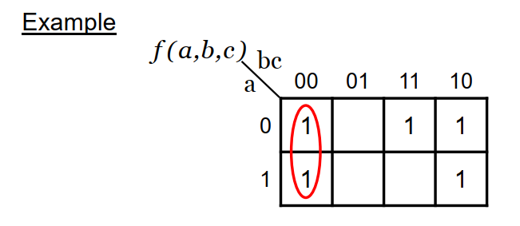

The sum of two minterms in adjacent cells can be simplified to a single product (AND) term with one less variable.
If we combine adjacent minterms in the first column we get,
That is, variable a is eliminated.

Slide 25
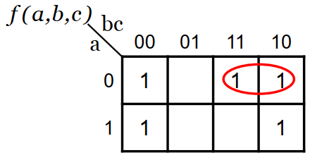

variable c is eliminated.

Slide 26
K-Map Based Minimization
The purpose of using K-maps is to aid in the simplification of logic expressions.
Use of 1’s in K-maps gives minterm SOP form directly. Use of 0’s in K-maps gives maxterm POS form directly.
Minterms (maxterms) that can be combined differ in exactly one bit position.
Minimization using K-maps is done by grouping “adjacent” minterms (maxterms).

Slide 27
Conditions for grouping
Minterm (maxterm) groups are restricted to have size that is a power of 2, e.g., 1, 2, 4, 8, …
All K-map cells in a group must have a 1 as their K-map entry for grouping minterms (or 0 as their K-map entry for maxterm groups).
All minterms (maxterms) must be adjacent; they must differ in exactly i bits where, 2i is the size of the group.

Slide 28
To minimize a function, find the set of groups which include all the required minterms; the function is the sum of these groups (or if maxterms are used then the function is the product of the groups).
The larger the groups, the better.

Slide 29
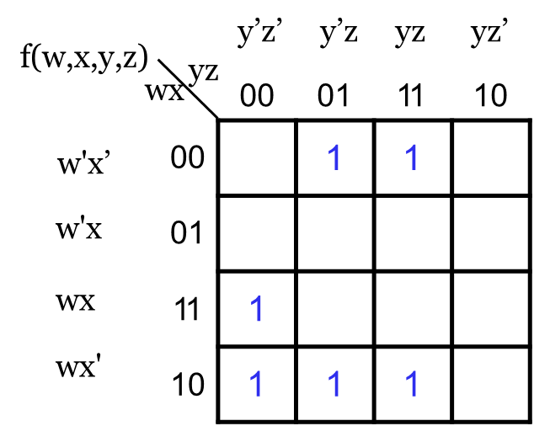
Example: Grouping Minterms
Simplified Expression:
f(w,x,y,z) = = x z + wyz

Slide 30
Example: Grouping Maxterms

Slide 31
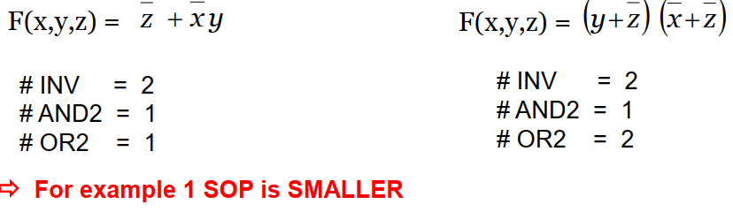
yz
yz
 | 00 | 01 | 11 | 10
0 | 1 | 0 | 1 | 1
1 | 1 | 0 | 0 | 1
x
 | 00 | 01 | 11 | 10
0 | 1 | 0 | 1 | 1
1 | 1 | 0 | 0 | 1
x
Sum of Products
Product of Sums

Slide 32
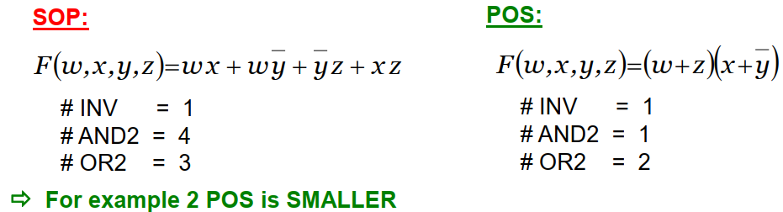
Logic Minimization: Example 2
yz
 | 00 | 01 | 11 | 10
00 | 0 | 1 | 0 | 0
01 | 0 | 1 | 1 | 0
11 | 1 | 1 | 1 | 1
10 | 1 | 1 | 0 | 0
wx

